Slide 1
Category Theory and Software Engineering
Yi Li
3.23

Slide 2
Agenda
A Brief Introduction to Category Theory
Representative Applications in Software Engineering

Slide 3
What is Category Theory
A theory about structures
First introduced in 1940s, to explore relations between mathematical systems, e.g. Set, Group, and Topological Space
General abstract nonsense
-- Sound from 1940s

Slide 4
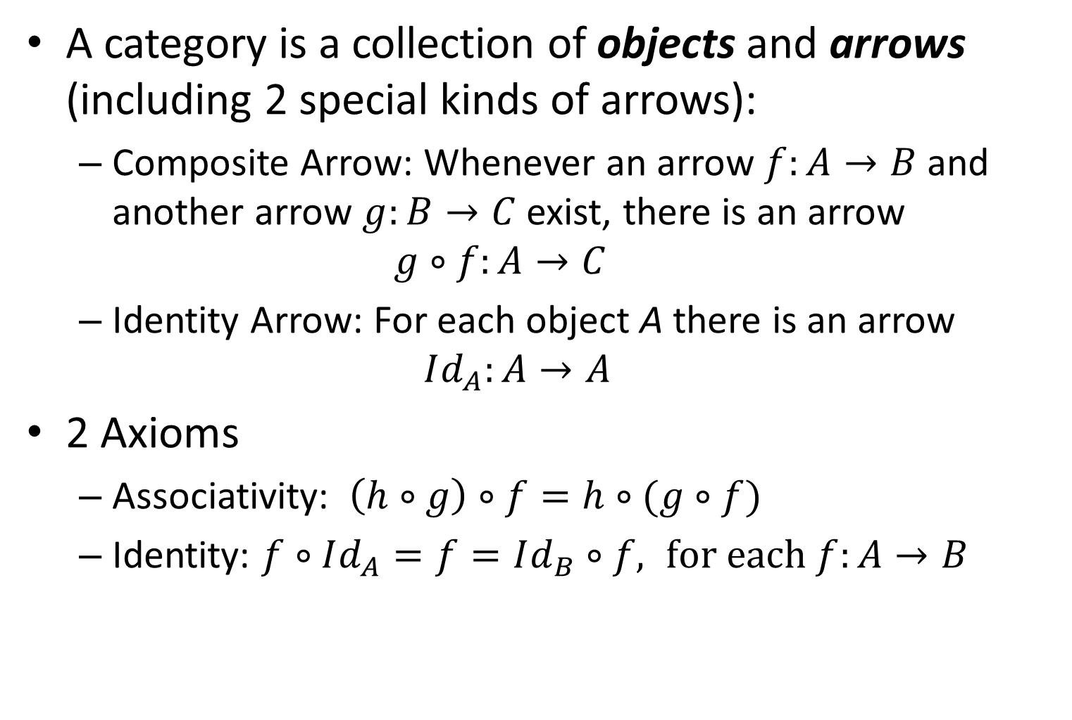
What is a Category
A category is a collection of objects and arrows (including 2 special kinds of arrows):
Composite Arrow: Whenever an arrow $f:A→B$ and another arrow $g:B→C$ exist, there is an arrow $g∘f:A→C$
Identity Arrow: For each object A there is an arrow $Id_{A}:A→A$
2 Axioms
Associativity: $\left(h∘g\right)∘f=h∘(g∘f)$
Identity: $f∘Id_{A}=f=Id_{B}∘f, for each f:A→B$
A
Id_{A}
A
f
B
Id_{B}
B

Slide 5
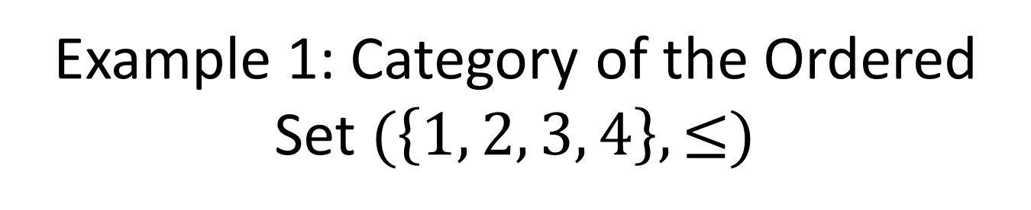
Example 1: Category of the Ordered Set $(\left\{1, 2, 3, 4\right\}, ≤)$
3
4
2
1
1
2
3
4
It can be simplified as
In this notation, the composite and identity arrows are assumed.

Slide 6



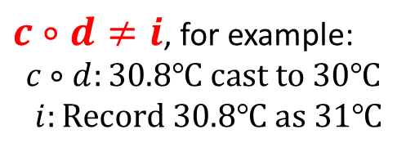
Example 2: Multi-Arrow Case
Temperatures
(A category of Sets)
d: Measured as
Real Number
i: Measured as Integer
c: java type casting
Composite arrows are not shown.
java.Double
java.Int
Multi-Arrow
$c∘d≠i$, for example:
$$c∘d:30.8℃ cast to 30℃$$
$i:Record 30.8℃ as 31℃$
$$c∘d$$
Temperatures
java.Int
$$i$$
Composite arrows are shown.
If $c∘d=i$, we say the diagram commutes.

Slide 7
Review: Basic Concepts & Terminology
In category theory, “co-” means “the opposite”
A
B
Arrow
or
Morphism
or
Map
Source
or
Domain
Target
or
Codomain
Never named as “Function” since it is not always a function.
DR Members
favorite
Movies

Slide 8
What’s really important: Operations
Operations on categories provide formal specifications on -- reasoning about structure mappings that preserve structure with certain properties, such as: Completeness: the operation works in every situation. Minimality: the result is minimal.
Operation List:
initial, terminal
product, coproduct
limit, colimit
cone, cocone
equalizer, coequalizer
pullback, pushout
…

Slide 9
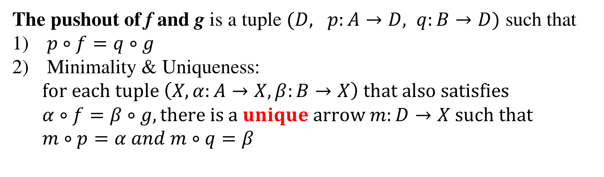



Pushout
C
f
A
Input
$$f:C→A, g:C→B$$
g
B
The pushout of f and g is a tuple $(D, p:A→D, q:B→D)$ such that
$p∘f=q∘g$
Minimality & Uniqueness: $for each tuple \left(X, α:A→X,β:B→X\right) that also satisfies$ $α∘f=β∘g, there is a unique arrow m:D→X such that$ $m∘p=α and m∘q=β$
C
f
A
g
p
$$α$$
B
D
q
m
$$β$$
X

Slide 10
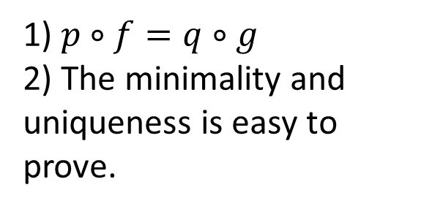
Compute Pushout for Sets
g(x) = x / 2
f(x) = x
1
2
3
1
2
3
4
1
2
3
4
f
C
A
Input
g
B
B
C
A
Combine elements with the same domain, and copy others. Morphisms p and q are trivial.
1
2
3
4
f
p
(1_{A})
(2_{A}, 1_{B})
(3_{A})
(4_{A}, 2_{B})
(3_{B})
1) $p∘f=q∘g$
2) The minimality and uniqueness is easy to prove.
1
2
3
4
C
A
1
2
3
g
q
B
D

Slide 11




Pullback
A
Input
$$f:A→C, g:B→C$$
f
g
B
C
The pullback of f and g is a tuple $(D, p:D→A, q:D→B)$ such that
$f∘p=g∘q$
Minimality & Uniqueness: $for each tuple \left(X, α:X→A,β:X→B\right) that also satisfies$ $f∘α=g∘β, there is a unique arrow m:X→D such that$ $p∘m=α and q∘m=β$
X
$$α$$
m
D
p
A
$$β$$
q
f
B
C
g

Slide 12
Compute Pullback for Sets
f(x)=2x
g(x)=x / 2
1
2
3
2
4
6
8
2
4
8
16
Input
A
C
B
Combine elements with the same codomain, discard others.
It’s also easy to prove the minimality and uniqueness.
A
1
2
3
2
4
6
8
(1_{A}, 4_{B})
(2_{A}, 8_{B})
2
4
8
16
D
C
B

Slide 13
Pullback, Pushout & Model Transformation
C
f
A
Pushout: Given a base model C and two delta models A and B, merge A and B. Conflicts may appear in the elements came from C.
Pullback: Given a final model C and two intermediate models A and B, compute the common model of A and B.
g
p
B
D
q
D
p
A
f
q
B
C
g

Slide 14
Agenda
A Just-Enough Introduction to Category Theory
Representative Applications in Software Engineering
Mehrdad Sabetzadeh, Steve Easterbook Merge inconsistent viewpoints
Adrian Rutle, Yngve Lamo et al. Version control in MDE

Slide 15
Work #1: Merge Inconsistent Viewpoints
Analysis of Inconsistency in Graph-Based Viewpoints: A Category-Theoretic Approach (ASE 03)
View Merging in the Presence of Incompleteness and Inconsistency (RE Journal 06)

Slide 16
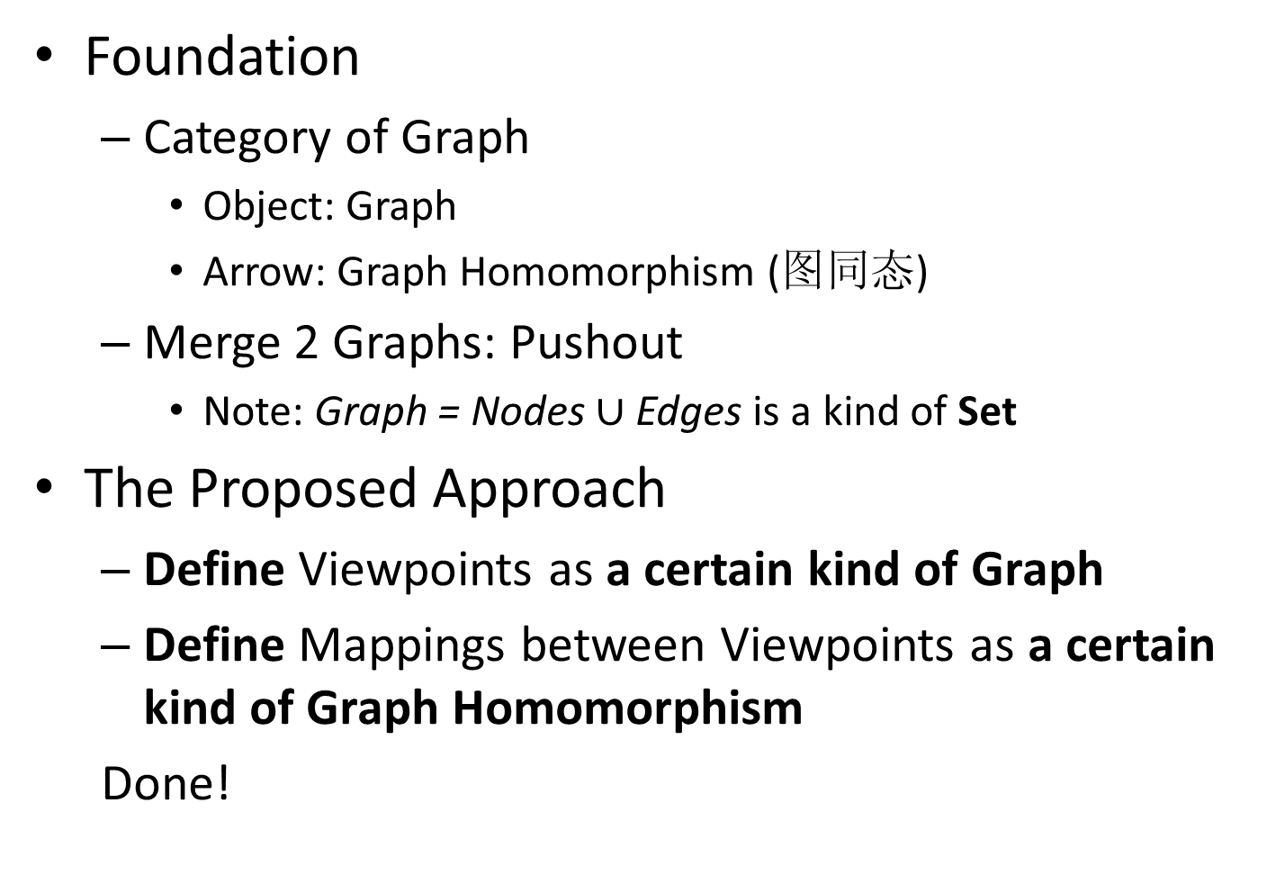
At a Glance
Foundation
Category of Graph
Object: Graph
Arrow: Graph Homomorphism (图同态)
Merge 2 Graphs: Pushout
Note: Graph = Nodes $∪$ Edges is a kind of Set
The Proposed Approach
Define Viewpoints as a certain kind of Graph
Define Mappings between Viewpoints as a certain kind of Graph Homomorphism
Done!

Slide 17
1. Viewpoint as Truth-Value-Labeled Graph
Viewpoints are… locally managed… objects encapsulating partial… knowledge about a system and its domain.
-- A Framework for Expressing the Relationships Between Multiple Views in Requirements Specification (TSE ‘94)
Focus on graphic viewpoints ➔ Viewpoint = Graph
Express knowledge as truth-values that form a complete lattice ➔ Viewpoint = Truth-value-labeled Graph

Slide 18
Knowledge as Truth Values
1 stakeholder: {Maybe, False, True}
He might be happy.
He is not happy.
He is happy.
2 stakeholders: A pair of truth values
(Virtual) Incompatible
F
T
M
(Virtual) Incompatible
Agreement / Disagreement
FT
TT
FF
TF
Partially Known
MT
FM
TM
MF
Unknown
MM

Slide 19
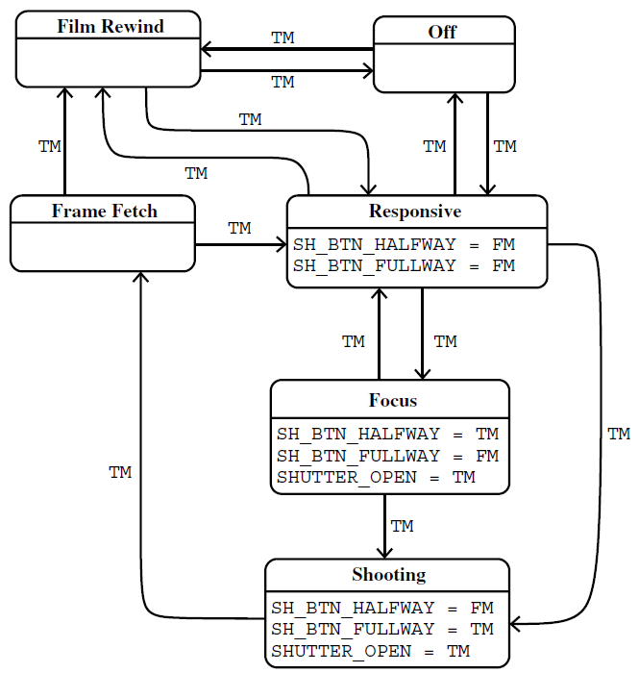
Example: Camera State Machine
(Stakeholder 1)
A state machine in one stakeholder’s
perspective. The M means there is another stakeholder whose knowledge is unknown to the current stakeholder.
Atomic Proposition

Slide 20
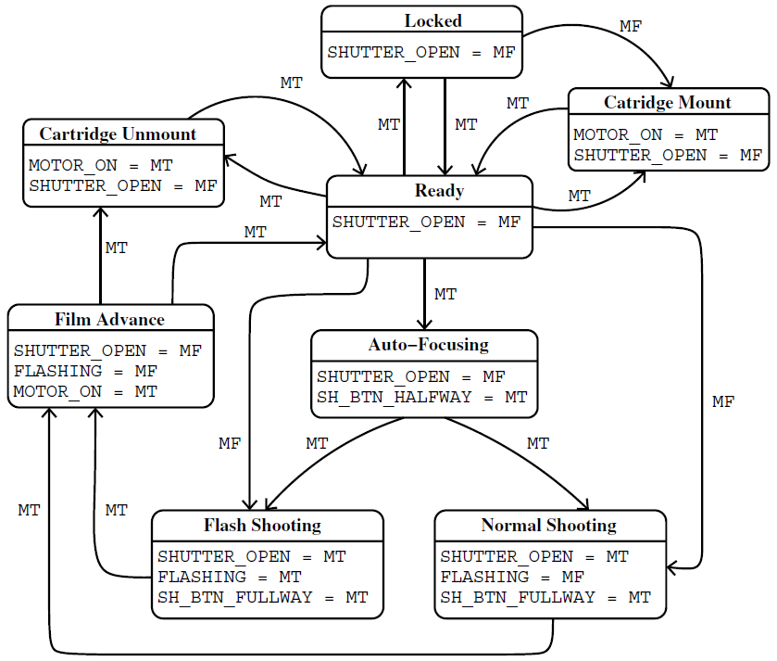
Example: Camera
(Stakeholder 2)

Slide 21
Review: What is a Viewpoint
A viewpoint is a truth-value-labeled graph G, in which:
The truth values form a complete lattice.
Every edge of G is labeled with a truth value.
Every node of G contains a set of atomic propositions (SAP) that are also labeled with truth values.

Slide 22
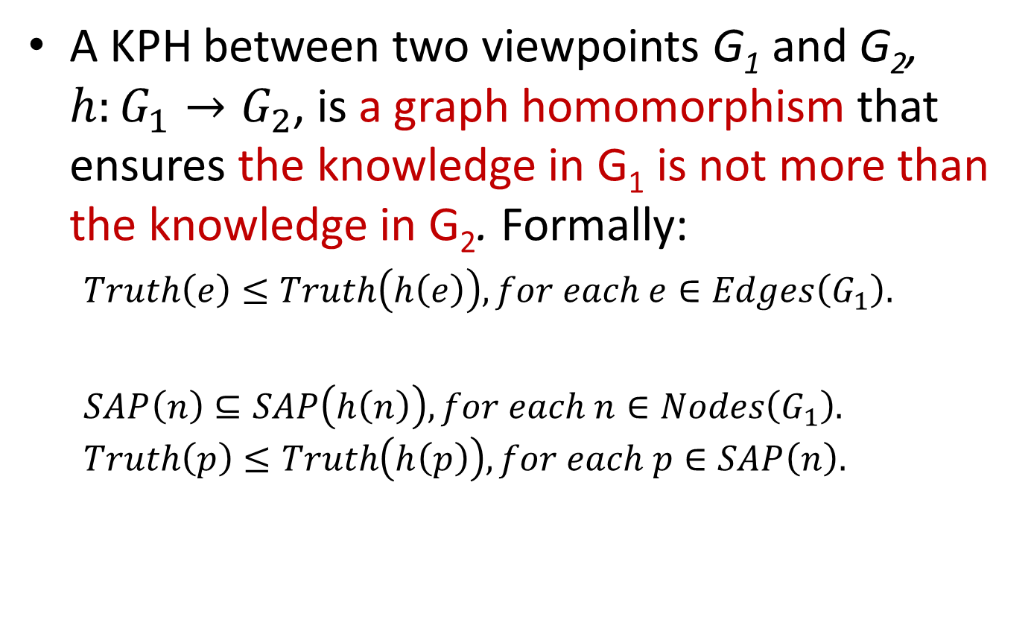
2. Arrow between Viewpoints as Knowledge-Preserving Homomorphism (KPH)
A KPH between two viewpoints G₁ and G₂, $h:G_{1}→G_{2}$, is a graph homomorphism that ensures the knowledge in G₁ is not more than the knowledge in G₂. Formally:
$Truth\left(e\right)≤Truth\left(h\left(e\right)\right), for each e∈Edges\left(G_{1}\right).$
$SAP\left(n\right)⊆SAP\left(h\left(n\right)\right), for each n∈Nodes\left(G_{1}\right).$ $Truth\left(p\right)≤Truth\left(h\left(p\right)\right), for each p∈SAP\left(n\right).$

Slide 23
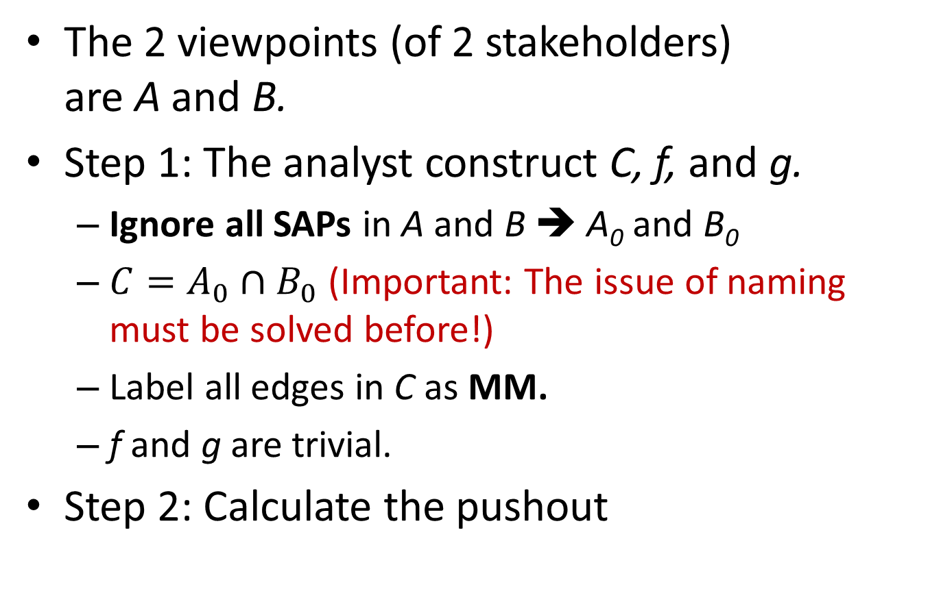
3. Calculate Pushout of 2 Viewpoints
C
f
A
The 2 viewpoints (of 2 stakeholders) are A and B.
Step 1: The analyst construct C, f, and g.
Ignore all SAPs in A and B ➔ A₀ and B₀
$C=A_{0}∩B_{0}$ (Important: The issue of naming must be solved before!)
Label all edges in C as MM.
f and g are trivial.
Step 2: Calculate the pushout
g
p
B
D
q

Slide 24
Name Mapping & Common Model
(7) Film Rewind
(1) Locked
1
2
7
4
5
3
6
(2) Responsive
(6) Film Advance
(1) Locked
(3) Focusing
(7) Film Rewind
(2) Responsive
(3) Focusing
(4) Flash Shooting
(6) Film Advance
(5) Non-Flash Shooting
(4) Flash Shooting
(5) Non-Flash Shooting

Slide 25
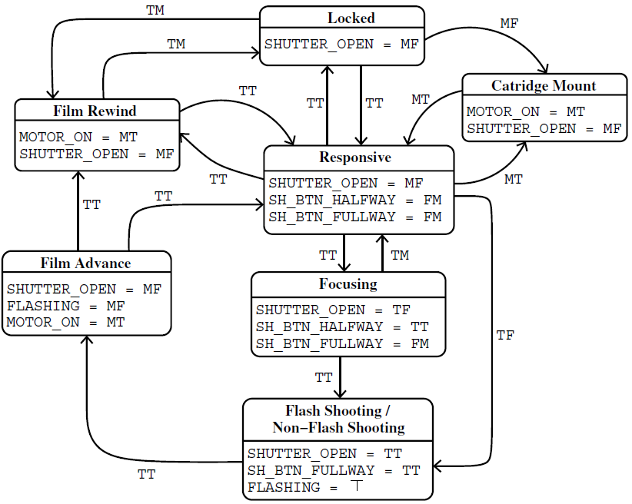
Merged Model
Merge truth values t and s ➔ the least upper bound of (t, s)
FT
TT
FF
TF
MT
FM
TM
MF
MM
3 conflicts

Slide 26
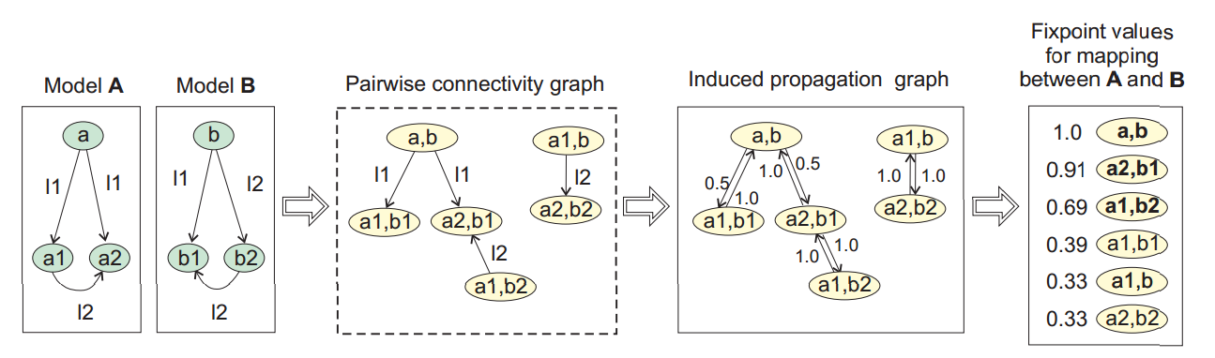
Discussion
1. No SAPs: The truth values are labeled on nodes
2. Node Mapping
See work on “Schema Matching” in Databases, e.g. Similarity Flooding

Slide 27
Work #2: Version Control in MDE
A formalisation of the copy-modify-merge approach to version control in MDE (Journal of Logic and Algebraic Programming 2010)
Detect conflicts of changes or… Merge change-labeled graphs

Slide 28




Problem Statement
(Base Model)
?
Global Repository
V₀
$$V_{0}+Δ_{1}$$
checkout
commit
commit
Local Workspace 1
V₀
$${V_{0}+Δ}_{1}$$
Local Workspace 2
V₀
$$V_{0}+Δ_{2}$$
Time
Merge $Δ_{1}$and $Δ_{2}$, and detect conflicts
NOTE: In version control systems, only the $Δ$ is committed.

Slide 29

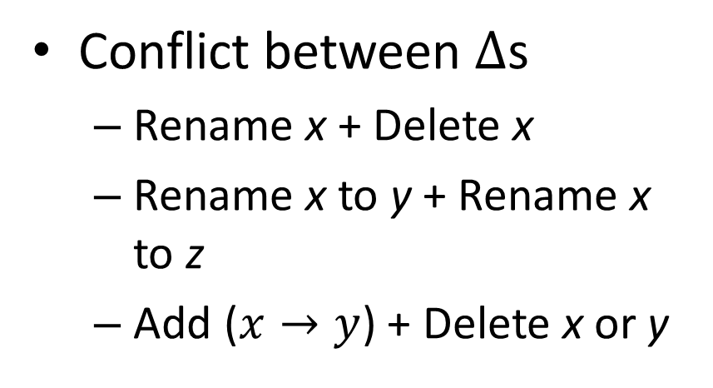
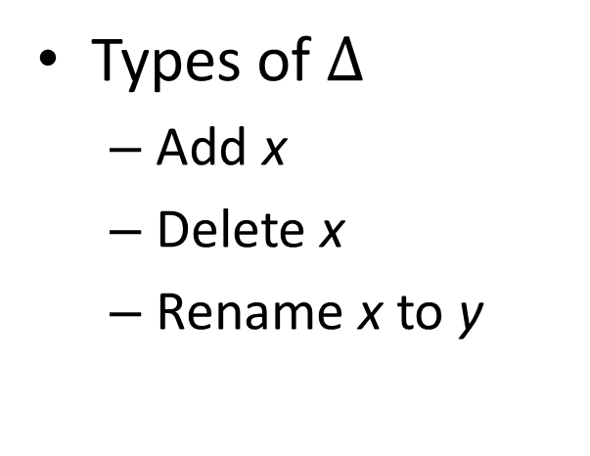



The Idea
$$V_{0}$$
$$V_{0}+Δ_{1}$$
Pushout
$$V_{0}+Δ_{2}$$
$$V_{0}+Δ_{1}+Δ_{2}$$
The arrows are graph homomorphisms.
Types of $Δ$
Add x
Delete x
Rename x to y
Conflict between $Δ$s
Rename x + Delete x
Rename x to y + Rename x to z
Add ($x→y$) + Delete x or y

Slide 30
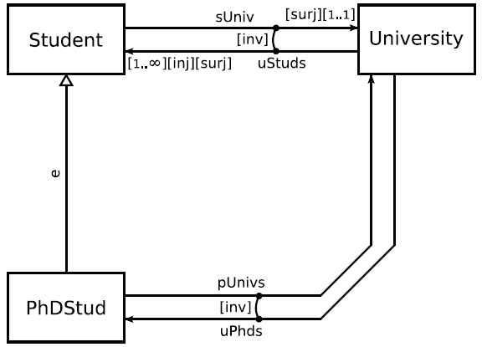
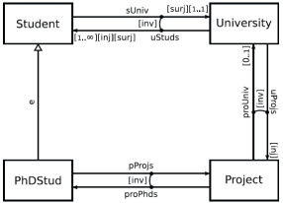
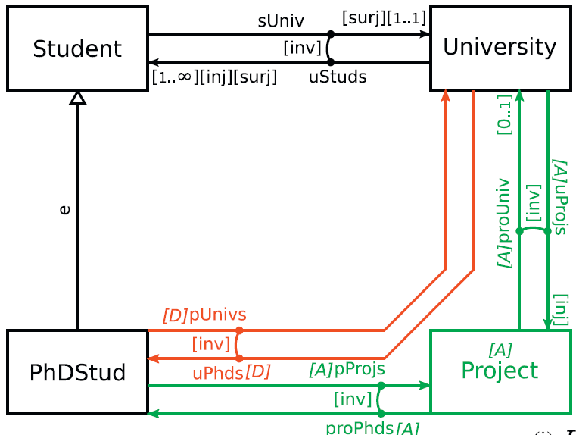
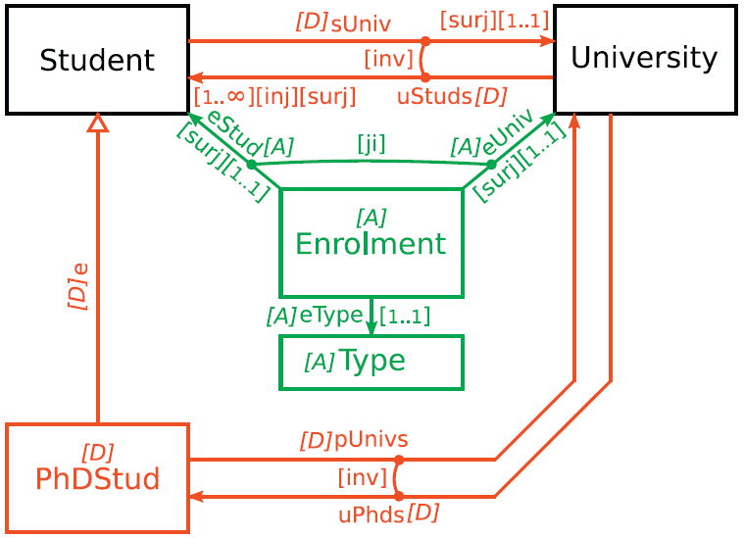
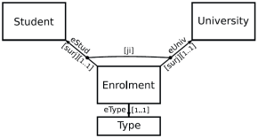
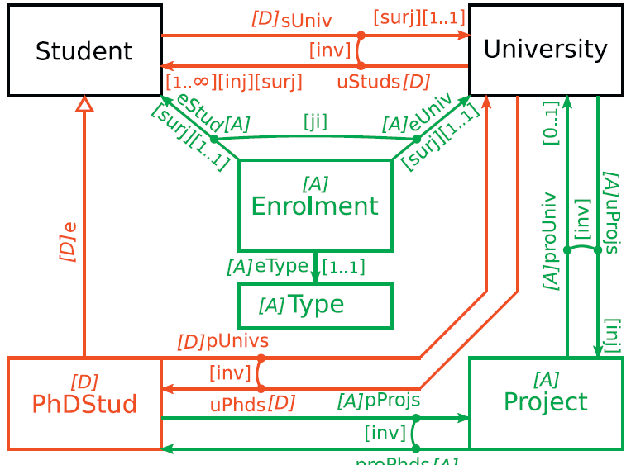




Add
Delete
$$V_{0}$$
$$V_{0}+Δ_{1}$$
$$V_{0}+Δ_{2}$$
$$V_{0}+Δ_{1}+Δ_{2}$$
Conflict!

